Slide 1

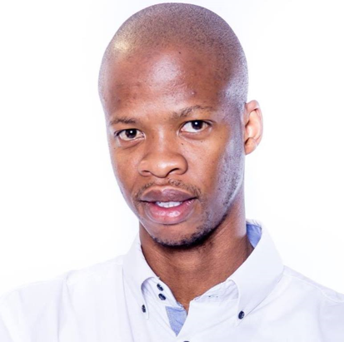
Machine Learning Challenge
Big Data Citizen Program
Team Name : VodaNumpys - South Africa
Michael Kaudi
Specialist: Radio Planning and Optimization
South Africa
Technology
" I joined the program so I can enhance my understanding of the Big Data field and how it can simplify and make more efficient the day-to-day activities. This with the aim of pursuing a career in this field.
Mohau Masukela
Specialist: Radio Planning and Optimization
South Africa
Technology
“I joined because Data Science is one of the fastest growing industries and all major organizations are using it to learn their customers behavior towards their product and how they can improve to keep clients or improve on customer satisfaction”
Further together

Slide 2
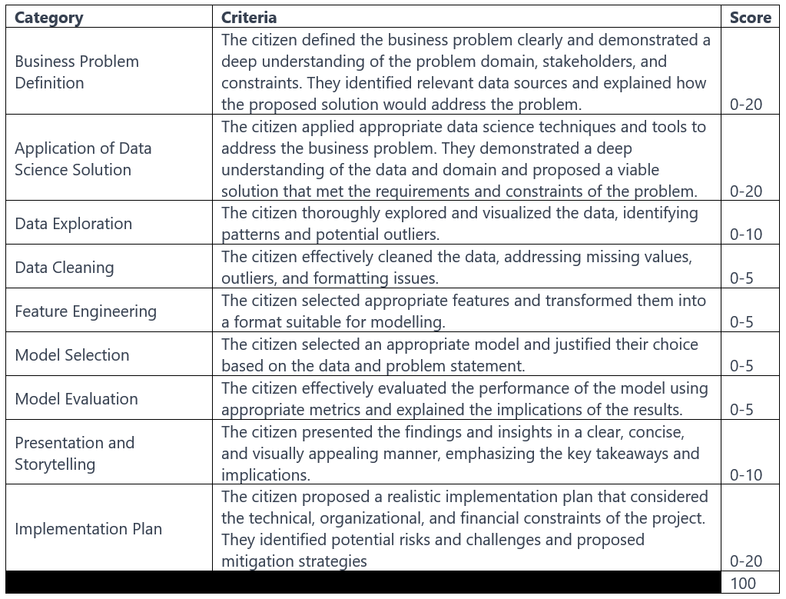
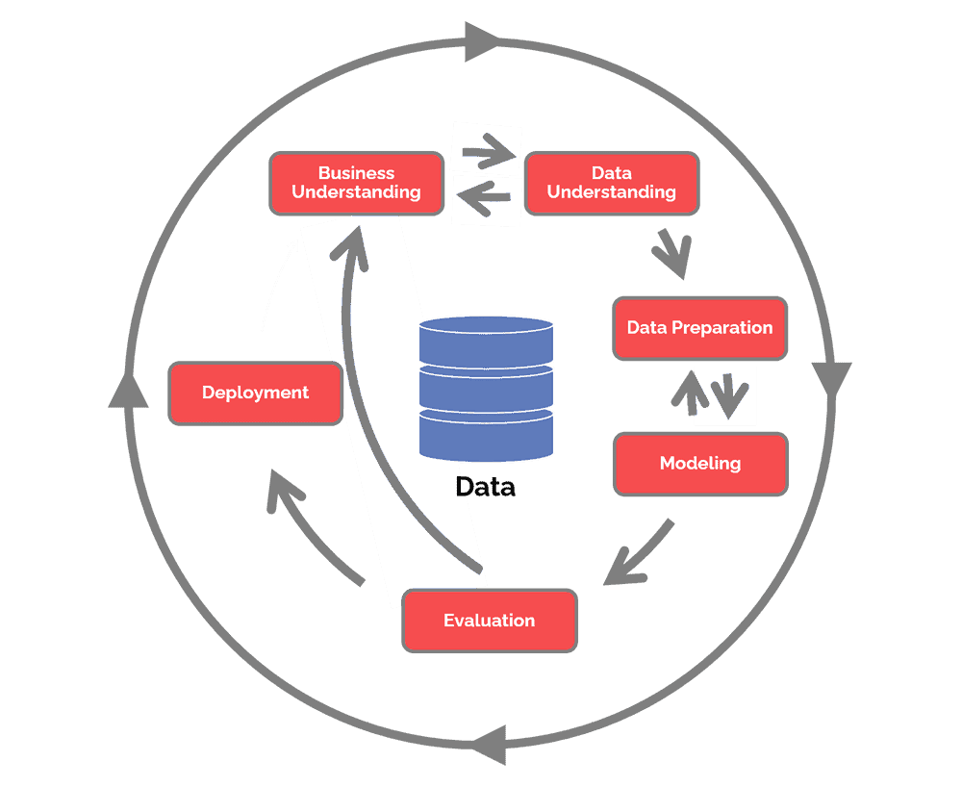
Business Problem
(Be guided by the rubric for each section)

Slide 3
Business Poblem | VodaPay
What?
Why?
Data?
Will a VodaPay customer be active or not in the following month based data of past user behaviour resulting in active and inactivity.
Active users contribute positively to revenue to Vodacom and provide Vodacom with an opportunity to impact customer’s lives positively by the products we provide.
Using the data collected over a 4 months period. The data includes user id’s, registration dates, platforms used to interact with the app search events and user expenditures over different periods.

Slide 4
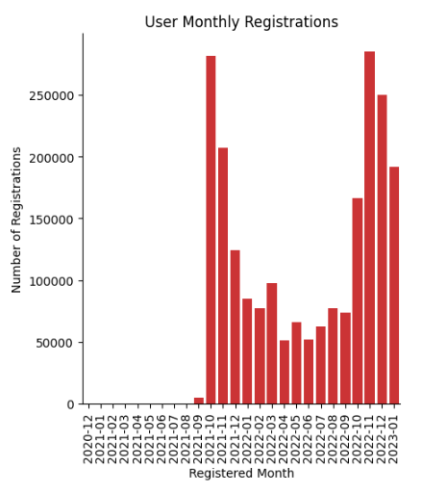
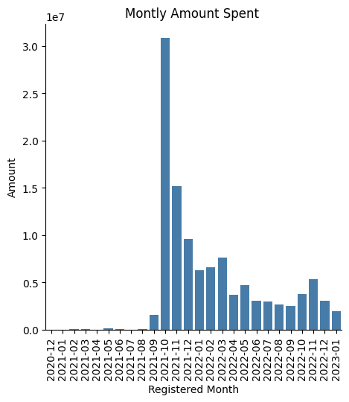
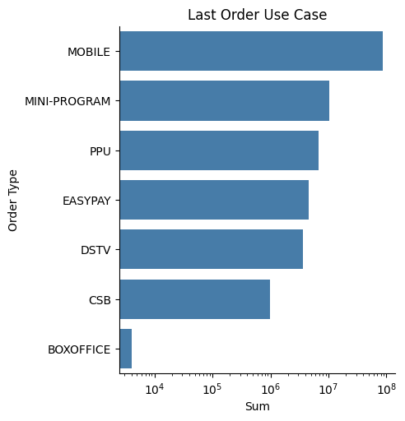
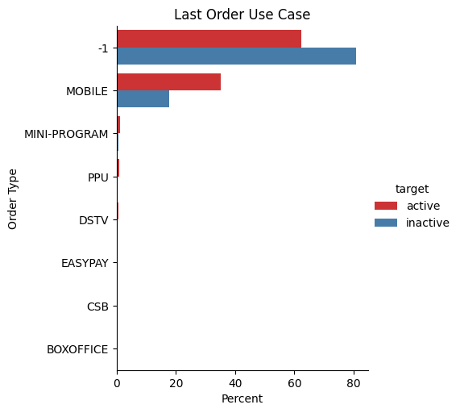
Data Exploration
Yearly, registrations pick up between the months of October and december.
Related to the App’s launch and anniversary promotions.
User registrations spikes are not translating to increased expenditure on the app.
Most users interact with the app by means of their mobiles.
High percentage of active users use the MOBILE platform to interact with the app than inactive.

Slide 5
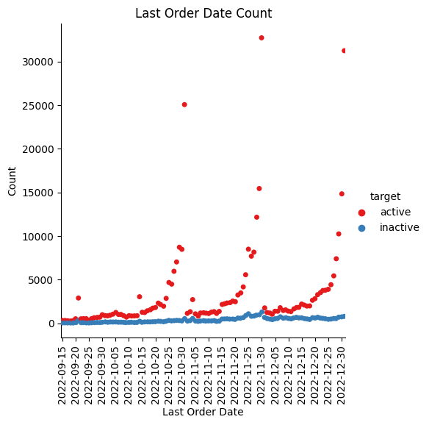
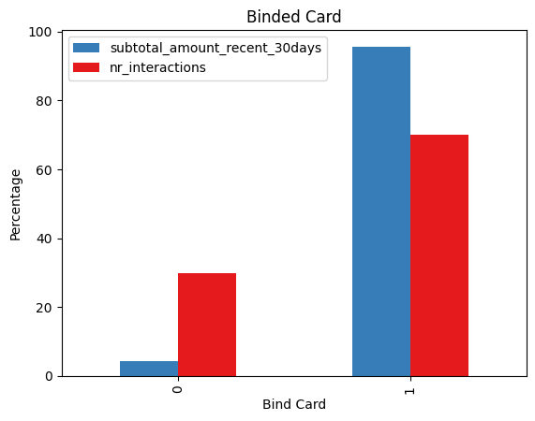
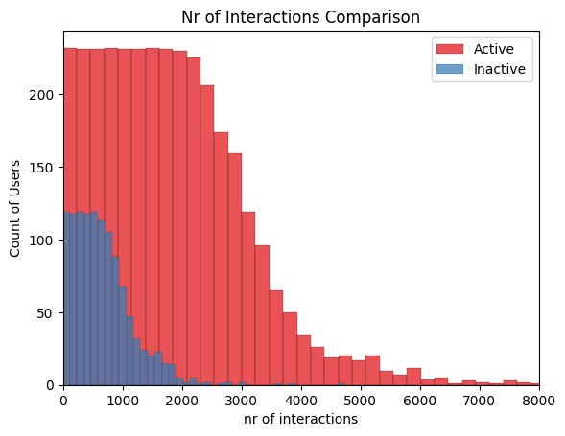
Data Exploration
Orders for active users increase sharply during month-ends.
Users who have their cards linked to the app, tend to interact and spend more than those that have not.
There are more active users than inactive users and they have higher interactions than the inactive users.

Slide 6
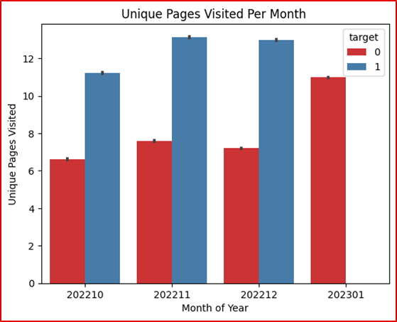
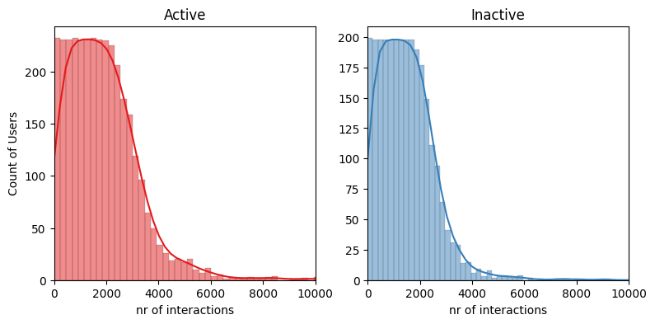
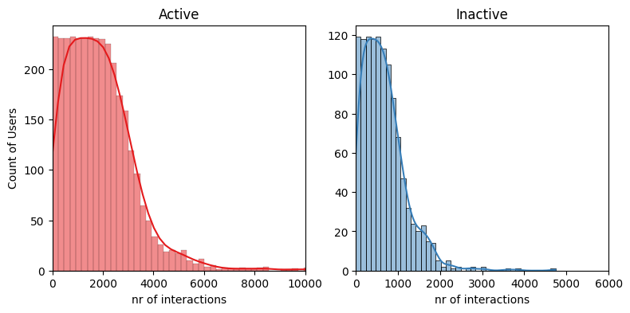
Data Cleaning
Pre
All user status’ for January 2023 is flagged as inactive. Possible error in the data
Post
All user status’ for January 2023 is flagged as inactive. Possible error in the data.
The data was removed from the data set and pre and post histograms show that the trend is not lost

Slide 7
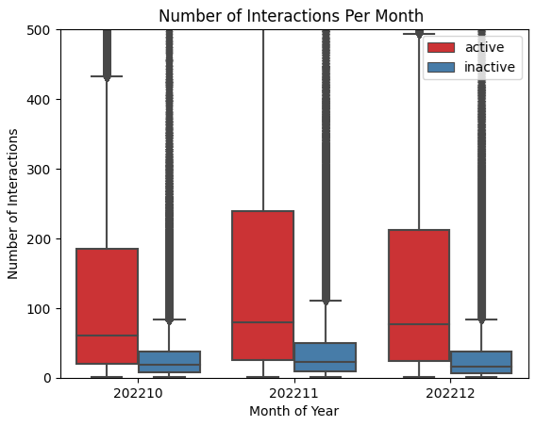
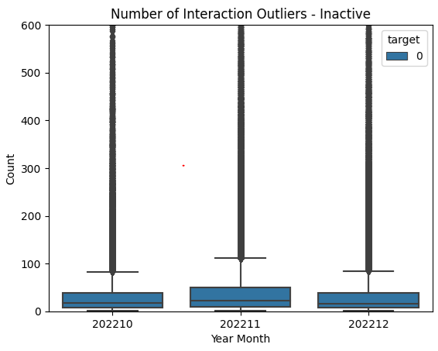
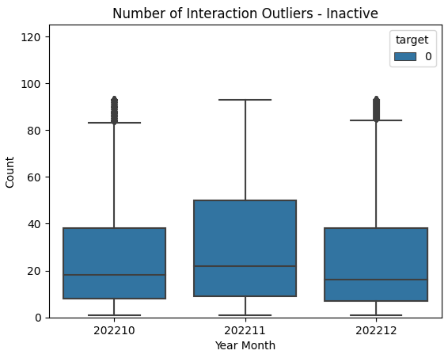
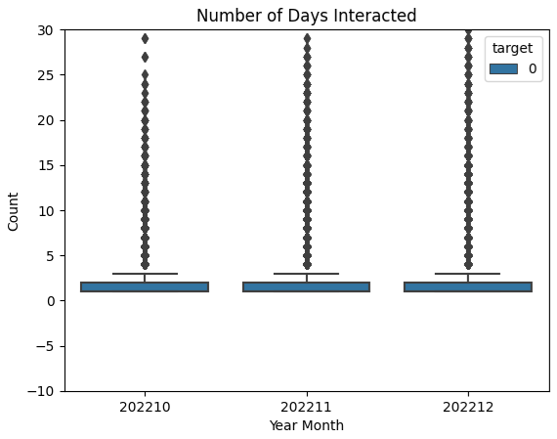
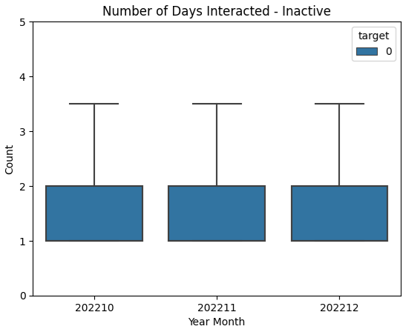
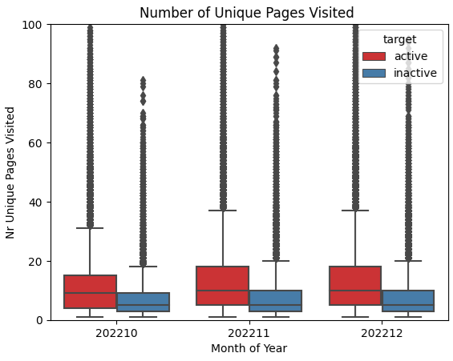
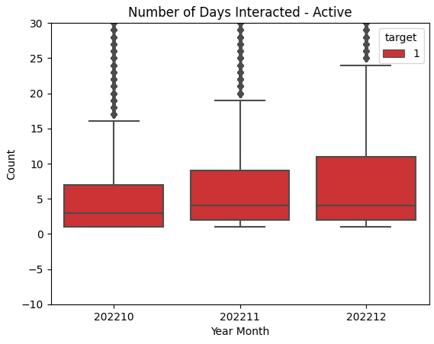
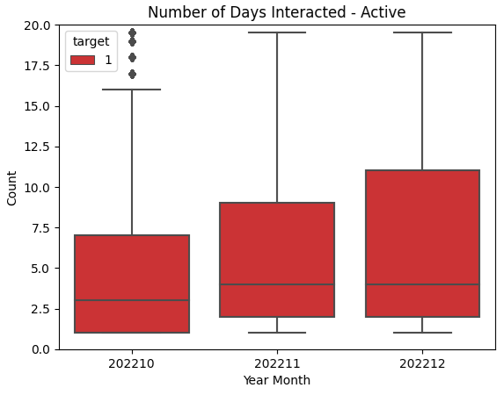
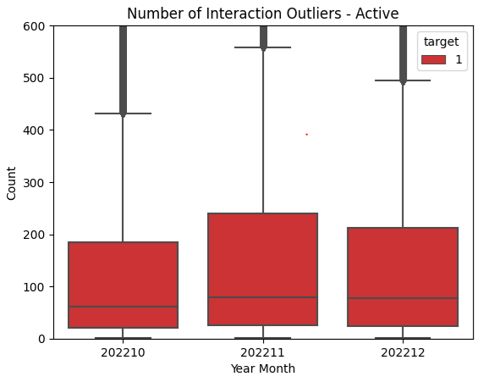
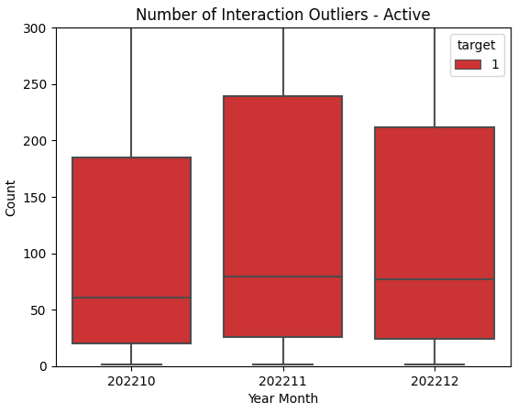
Data Cleaning
Capped the outliers, IQR

Slide 8

Data Science Solution
What : Data Prep
What : Modelling
What : Output
Nr Interactions
User interactions with app
Platfrom
Users interaction mode
Bank Card Linked
Months active
Spend
User spend on the app
Will a user be active or inactivity the following month
Modelling data
DecisionTreeClassifier
model
Customer
Notes:
Summarize your range of features in the circle above.

Slide 9
Data Wrangling
Missing values:
Lastorder_orderdate was dropped due to having a high number of nulls (1562760).
Columns “Unnamed: 0” and ‘hashed_user_ids” were dropped as they were not providing value.
Data errors:
Data of 2023-01 showed all users as inactive. This data was dropped as it showed abnormal behaviour which could possibly be an error during data collection.
Feature Engineering:
months_active: the number of months a user was active.
nr_days_on_app: The number of days being on the app.
regist_month: the month a user registered on the app.
Formatting / Encoding
The date was changed from object to datetime type.
All “-1” formatted to nulls.
Categorical columns, lastorder_platform and lastorder_usecase, transformed to numerical values by using 0/1s.
Status changed to 0/1s.

Slide 10
Model snapshot : how accurate is you model
Train / Test
Model name | Big Data Citizen Program: South Africa, VodaPay
Business goal | To identify customers that have a high probability of being inactive the following month.
Model Base: | Active and inactive users’ data
Training Data | Historical interactivity, expenditure, bank card linkage and period of activity data of users.
Training period | 3 Months of activity. From 2022-10 till 2022-12
Modelling Method | DecisionTreeClassifier
Justification for choice of algorithm | The classifier handles large dataset efficiently as well as handling missing values.
AUC, Sensitivity, Specificity on Test data | 0.76, 0.88, 0.42
 | Train | Test
AUC |  | 0.76
Sensitivity |  | 0.88
Specificity |  | 0.42
Notes:
Got a good sense of the context of the model, here is the snapshot of methods and output.
Specificity and Sensitivity: A higher sensitivity indicates a lower false positive rate and conversely a higher specificity indicates a lower false negative rate.

Slide 11
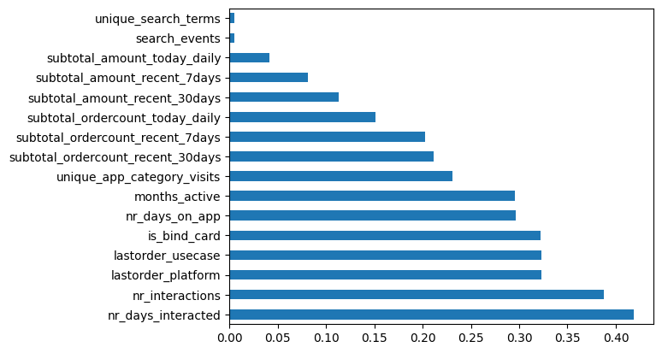
Feature Importance
Feature ‘nr_days_interacted’ is most predictive of the target variable whilst Feature ‘unique_search_terms’ is least predictive.
Engineered features: nr_days_on_app, months_active rank high.
Top 5 Features
nr_days_interacted: frequent interactions with the app gives user chance to.
transaction_platform: mode the user uses to interacts with VodaPay.
is_bind_card: has the user linked a bank card on VodaPay.
nr_days_on_app: how many days has been on the app.
months_active: months a user has been on the app.
Notes:
feature_importance = pd.DataFrame(xgmodel.feature_importances_,index = X.columns,columns=['importance']).sort_values('importance',ascending=False)
feat_importances = pd.Series(xgmodel.feature_importances_, index=X.columns)
feat_importances.nlargest(30).plot(kind='barh')

Slide 12
Improvement Ideas
“Please call me” concept: a user can request data from another through the VodaPay app.
Relook at redesigning the app to be more user friendly.
Visibility marketing onsite at partner stores with discounts to encourage app usage.
Come up with VodaPay focused media adverts detailing specific benefits.
Reward users on activity anniversaries (3months/6months/12months etc).
Investigate streamlining apps: remove apps users has not used for a certain amount of time but can still search them.
As soon as user installs and registers on VodaPay – prompt users to disable/migrate the MyVodacom App profile to VodaPay.

Slide 13




Thank you Merci beaucoup Asante sana Ke a leboha Obrigado
Notes:
Demo of finished model aimed at increasing the uptake and usage of the Airtime Advance facility.
Use case summary, Training data design, Model flow, design and performance, EDA insights into chosen features and finally campaign strategy and pilot discussions

